Slide 1
TNSDC - GENERATIVE AI FOR ENGINEERING
FINAL PROJECT
Submitted by
Gayathri R
(311521104014)

Slide 2

PROJECT TITLE
POETRY GENERATOR USING LSTM(Long Short Term Memory Networks)

Slide 3
Agenda
Problem Statement
Project Overview
End Users
Value Proposition
Solution
Modelling
Results

Slide 4
PROBLEM STATEMENT
Develop an LSTM-based Poetry Generator that, when given an initial cue, can produce poetry that is both coherent and pertinent to the setting. The goal is to create a system that can create unique compositions that follow the given input context by learning the nuances of poetic language and style from a dataset of poems.
Users should be able to specify the desired length and structure of the generated poem as well as enter prompts such as a theme, mood, or specific words into the generator. The generated poems should demonstrate creativity, evoke emotions, and maintain thematic consistency with the input prompt. The system's success will be evaluated based on the quality, coherence, and relevance of the generated poetry to the provided context

Slide 5
PROJECT OVERVIEW
The LSTM-based Poem Generator project aims to develop an innovative system capable of automatically generating original poetry based on user-provided prompts. Leveraging deep learning techniques, particularly Long Short-Term Memory (LSTM) networks, this project addresses the need for a versatile tool that assists writers, artists, and enthusiasts in exploring various themes and styles of poetry.

Slide 6
PROJECT OVERVIEW OBJECTIVE
Design and implement an LSTM-based model capable of learning from a dataset of poems.
Enable the model to generate coherent and contextually relevant poetry in response to user prompts.
Provide users with a platform to express creativity through poetry generation.
Enable users to explore various themes, styles, and structures in their poetry.
Inspire users to delve into literary exploration by generating diverse and captivating poems.
Aim to generate high-quality poetry that exhibits coherence and relevance to the input prompts.
Continuously refine the model based on user feedback to improve the quality of generated poems.

Slide 7
PROJECT OVERVIEW EXPECTED OUTCOME
A robust and user-friendly system capable of generating original and compelling poetry in response to user prompts. The generated poems should demonstrate coherence, creativity, and thematic consistency, thereby providing users with a valuable tool for artistic expression and creative exploration in the realm of poetry.

Slide 8
END USERS
Poets and Writers: Use the system for generating new ideas, overcoming writer's block, and experimenting with themes and styles in poetry.
Students and Educators: Utilize the system as a learning tool to explore various poetic forms, analyze generated poems, and inspire writing assignments.
Artists and Performers: Find value in the system for generating lyrical content, exploring new poetic concepts, and incorporating them into performances or artworks.
Creative Enthusiasts: Use the system for inspiration, relaxation, or personal enrichment, regardless of professional background.
Literary Communities: Use the system for collaborative writing projects, poetry challenges, and interactive workshops online or offline.

Slide 9
VALUE PROPOSITION
Our LSTM-based poetry generation system offers a transformative experience to poets, writers, educators, artists, and creative enthusiasts by providing a seamless platform for generating coherent and captivating poetry. With its ability to overcome writer's block, inspire creativity, and facilitate collaborative writing projects, the system empowers users to explore diverse themes, styles, and forms of poetry. Whether used for personal enrichment, academic exploration, or artistic expression, our system serves as a catalyst for literary exploration and community engagement, fostering a deeper appreciation for the art of poetry while enhancing the creative journey for individuals and literary communities alike

Slide 10
SOLUTION
Our solution comprises an LSTM-based poetry generation uses leveraging cutting-edge deep learning techniques, and learns from a curated dataset of poems to generate coherent and contextually relevant poetry in response to user prompts.
The innovation lies in the sophisticated model architecture, which incorporates Bidirectional LSTM layers, embeddings, and dropout techniques to capture the nuances of poetic language and style effectively. This enables our system to produce high-quality poetry that resonates with users, inspiring literary exploration and creative expression.

Slide 11
MODELLING
An embedding layer is used to transform words into dense vector representations, aiding the model's comprehension of semantic relationships.
Bi-directional LSTM layers are employed to process input sequences in both forward and backward directions, enhancing the model's ability to capture contextual information.
Dropout layers have been incorporated to prevent overfitting by randomly dropping a fraction of units during training, improving the model's generalization ability.
Dense layers are Utilized to map LSTM outputs to the vocabulary space, facilitating the prediction of the next word in the sequence.

Slide 12
Apply softmax activation function to the output layer to generate a probability distribution over the vocabulary,
Train the model on a dataset of poems using Adam optimizer with categorical cross-entropy loss function
Fine-tune hyperparameters such as learning rate, batch size, and epochs to prevent overfitting.
Evaluate the model's performance using metrics BLEU score to ensure coherence, relevance, and creativity.
Generate coherent and contextually relevant poetry in response to user prompts, leveraging learned patterns and structures from the training data to produce compelling output.
MODELLING

Slide 13
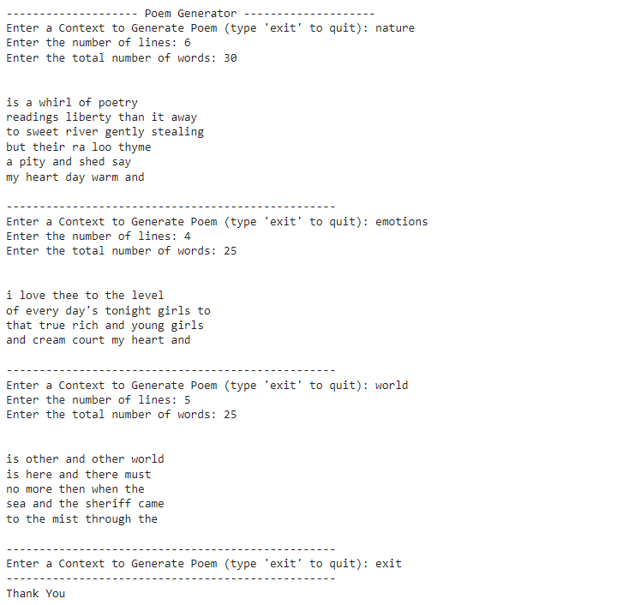
RESULTS
The results of our LSTM-based poetry generation system demonstrate its capability to produce coherent and contextually relevant poetry in response to user prompts. Through extensive training on a diverse dataset of poems, the model has learned to capture the intricacies of poetic language and style, enabling it to generate compelling and evocative poetry
The accuracy of the model (after training for 150 epoch) : 80.48%

Slide 14
Thank You
Project Link
https://github.com/Gayathri2505/GenerativeAI-NaanMudhalvan.git

